Slide 1


Slide 2



Hair loss is a visible health betrayal, at massive scale
It is not vanity, it is confidence, identity, and agency, and it affects most adults over time.
Who experiences this issue
Men, Women, and Children
In the US alone
80 million people
Two consumer realities
Ryan: early, fast-moving crown and hairline loss; high appearance-sensitivity.
Colleen: multi-generational thinning; concealment (wigs); wants her own hair back.
Experience androgenetic alopecia
(50M men + 30M women).
5-8 million combined for other hair loss conditions.
What people feel
Confidence damage and social anxiety.
Confusion and resignation: what works, why it happens, whether reversal is possible.
Agency loss: pushed into “daily forever” routines or surrender, instead of restoration.
Lifetime prevalence
85% Men / 40% Women
Experience androgenetic alopecia over time.
Global hair growth market: $9.2B (2025) → $12.3B (2034).

Slide 3
What people do today, and what it really costs
The market offers maintenance, procedures, or high-risk drugs, often requiring indefinite use.
Everyday maintenance
Procedures + devices
Systemic / other
Minoxidil: $20–$60/mo · ongoing · irritation; stops when you stop
Oral finasteride: $16–$70/mo · daily, indefinite · side effects; stopping reverses gains
Topical finasteride: $50–$100/mo · ongoing · systemic side effects still reported
PRP: $500–$2,500/session · 4–6 initial; 2–3/yr · variable outcomes
LLLT: $200–$3,000 upfront · ongoing · moderate benefit; durability unclear
Transplant: $4,000–$20,000+ · surgery + recovery · cash-pay; quality variability
JAK inhibitors (alopecia areata): $2,000–$5,000/mo · systemic · boxed warnings; serious risk
Natural/alternative topicals: varies · long timeline · limited rigor; inconsistent formulas
40-year cost (age 30–70): finasteride $7,680–$33,600 | minoxidil $9,600–$28,800 | combo $17,280–$62,400

Slide 4

The industry optimizes for maintenance, not restoration
Efficacy is slow and inconsistent, side effects deter use, adherence collapses, and costs compound over time.
Limited efficacy + slow timeline
22% Reported Improvement - Minoxidil
3-6 months for first signs of improvement
Side effects and risk trade-offs
Finasteride: sexual side effects, infertility, anxiety, and cognitive decline in long term users
Minoxidil: hypertrichosis: 25%, Scalp eczema: 16%, Shedding: 16%, Itching: 11%, Nightmares: 5%
13.7% adherence by year end for Minoxidil
Real-world Attrition
OTC minoxidil attrition reported at 86.3%. Continuation past 1 year: 12%
Finasteride adherence reported at 33% at 1 year; After 3 years only 12%
Costs and access barriers
Transplants are cash-pay ($4,000–$20,000+). “Affordable monthly” becomes large lifetime spend.

Slide 5

RESTORE
Regrowth by healing the scalp environment
A stress-free regeneration system that rebuilds tissue first, so hair growth becomes the natural outcome.
RESTORE
A topical regeneration therapy with 14 bioactive molecules delivered via HCC Hyalurosomes, applied 6 nights on / 1 night off to maintain 50–70% tissue saturation.
What is a HCC Hyalurosome
A type of liposome (Like a man-made cell) with a special gel core mesh made from Hyaluronic Acid.
Core promise
Instead of forcing hair growth with aggressive daily saturation, RESTORE supports continuous healing so follicles regain structure, protection, energy, and blood flow.
How it solves what fails today
Avoids plateau: 50–70% saturation window reduces desensitization.
Multi-target regeneration: structure + protection + energy + perfusion.
Lower friction: bedtime routine and long tissue residency.
Gentler signaling: moderate sustained concentrations + weekly rest day.
Key differentiators: HCC Hyalurosomes • 28–35 day dermal presence • CD44 targeting • Built-in 6-on/1-off protocol

Slide 6
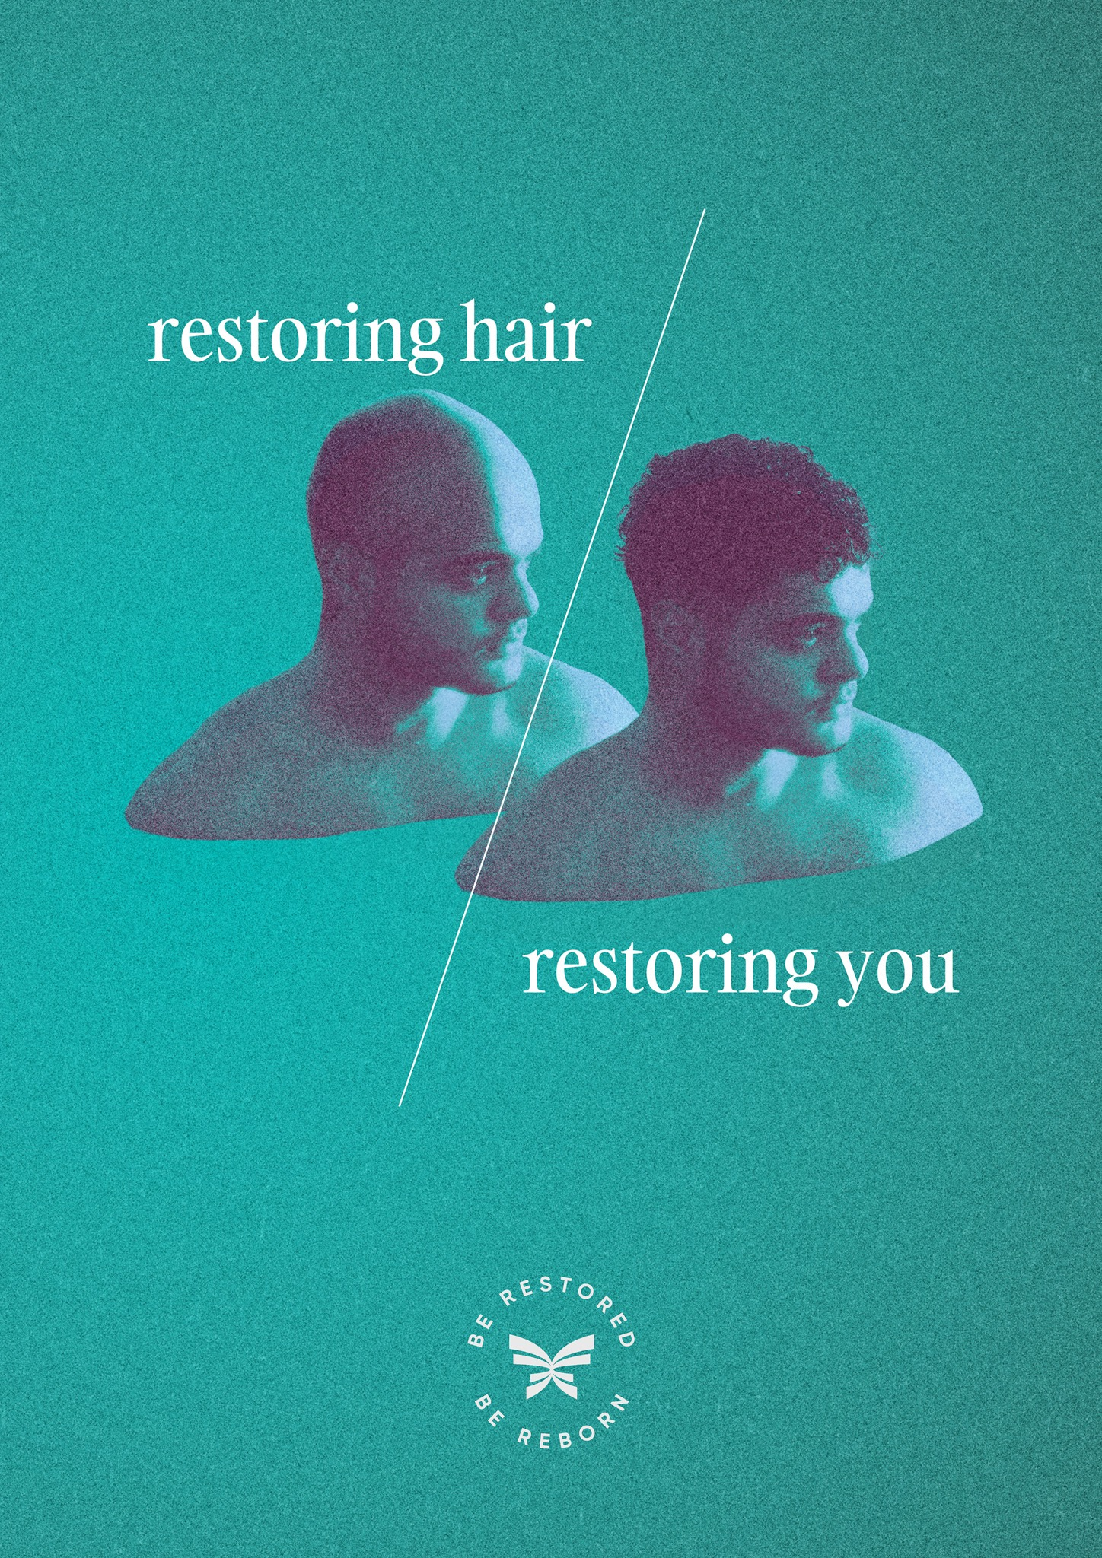
The Science: stress-free regeneration, delivered and timed
RESTORE maintains therapeutic signaling without over saturation, using a delivery system built for long tissue residency.
Mechanism (4 steps)
Regeneration pillars
Structural repair
Deliver and protect actives via HCC Hyalurosomes.
Hold concentration in the 50–70% window.
Activate: structure, protection, energy, perfusion.
Weekly rest day supports re-sensitization + repair.
Vitamin C • Ferulic • CoQ10 • Vitamin E • HA complex
Protection
Melatonin • Luteolin • Glutathione • EUK-134 • Phytic acid
Delivery system
Energy + metabolism
HCC Hyalurosomes (~150–200 nm)
• Encapsulate hydrophilic + lipophilic actives
• Dual MW HA network (110 kDa + 1000–1500 kDa)
• Described: 3.5–5× longer residence + CD44 targeting
Creatine • Carnitine • Adenosine • Inositol
Perfusion
L-Citrulline • Adenosine (dual role)
Protocol: Mon–Sat nightly • Sun rest • 6-on/1-off for receptor reset + healing consolidation

Slide 7
Financial Model
12-month projection, unit economics, and margin expansion
12-Month Projection
Unit Economics
Assumptions: $189/mo subscription; 92% monthly retention.
12 month Goal: 10,000 active monthly users; $22.7M 12 month revenue; $13.7M 12 month revenue EBITDA (60.6% margin).
COGS per unit: $12.10 (at 10K scale).
Gross margin: 93.6% ($176.90 per sub/mo).
Customer LTV: $4,650 (34-month avg lifetime).
Target CAC: $300.
LTV:CAC: 15.5x.

Slide 8


